Slide 1

Converting a Web App from ActionScript to JavaScript
Group 10
Presenters
Zach Yu
York Liu
Andrew Hampson
Peter Chen
Supervisor
Dr. Mandeep Pannu

Slide 2
Overview
Introduction
Group Organization
Project Phase
Live demo
Group Growth
Question Time

Slide 3

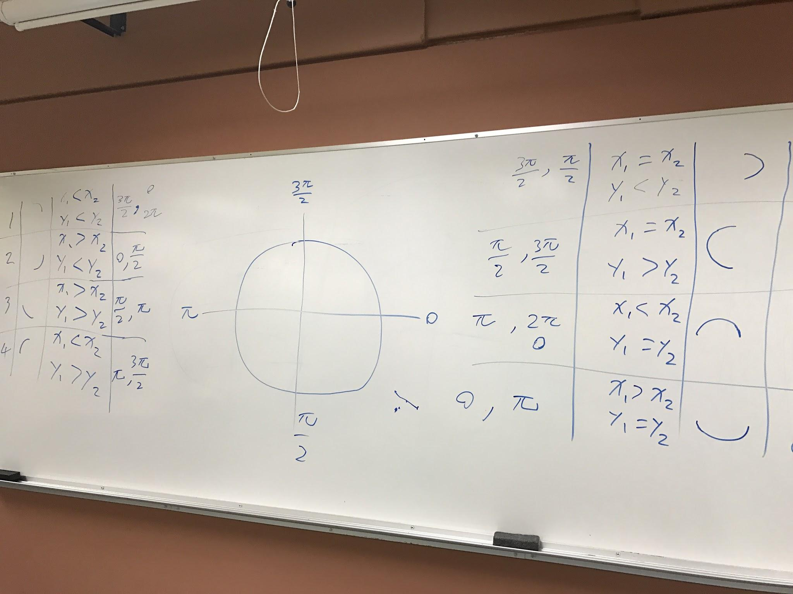
Group members
Zach: Coding, Project Manager
York: Documentation, Research data
Peter: Coding, Data Analysis
Andrew: Coding, Data Analysis

Slide 4

Leffler Software
Main Client
Shawn Leffler
East Coast, Phone call or Skype.
Football Playbook Web App owner
Tech support
Bethany Edmunds
Technical questions
Existing code and explanation

Slide 5
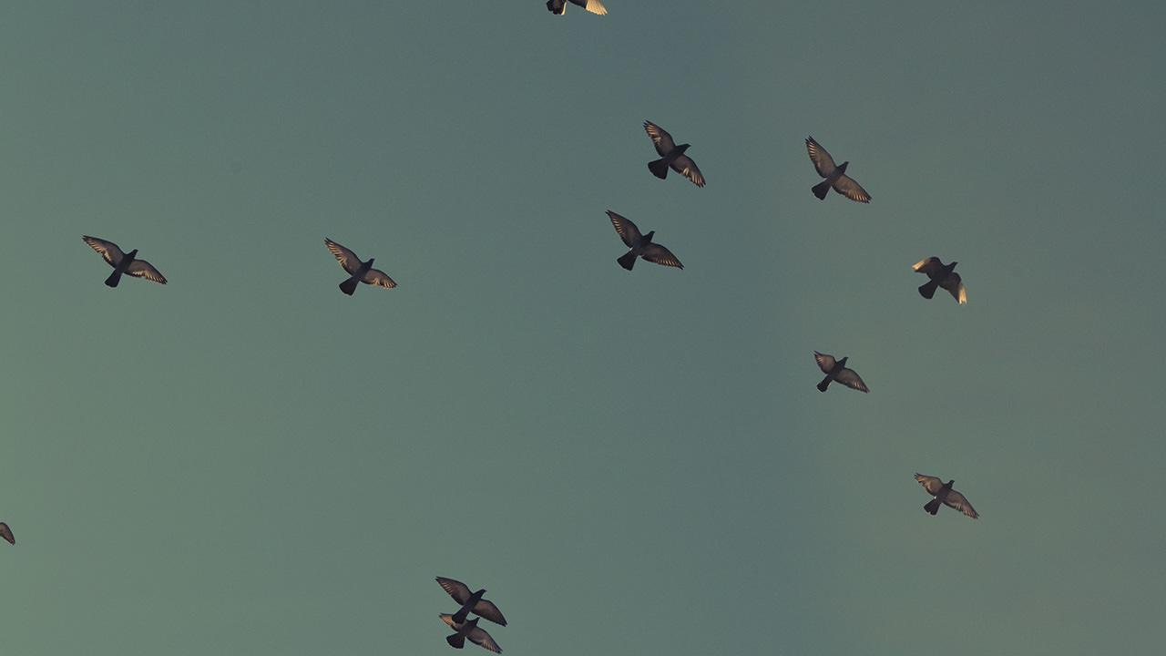
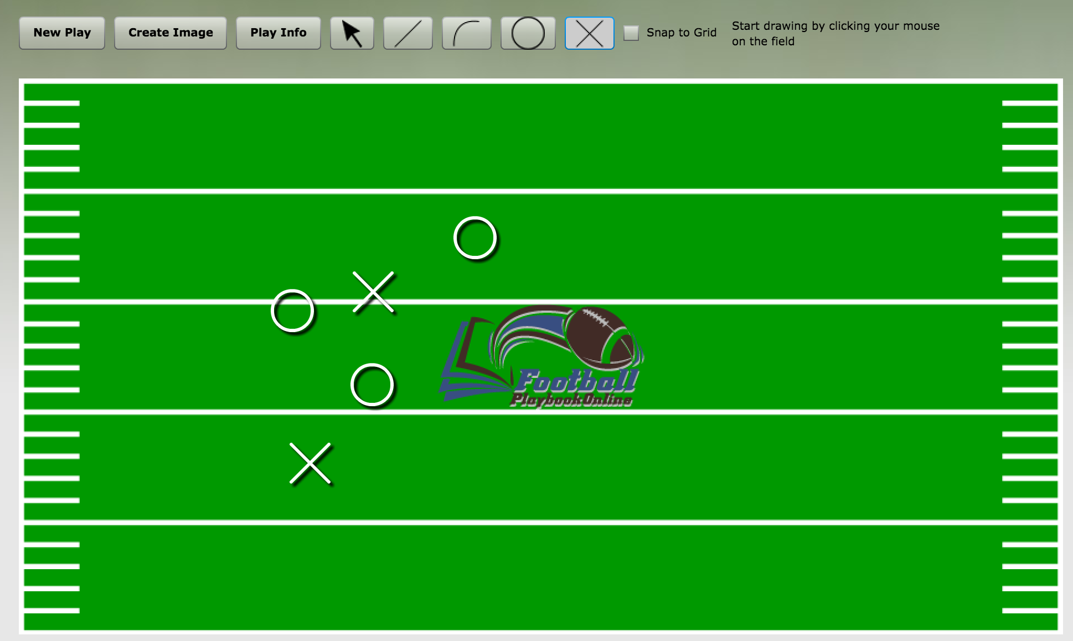
Background
The Football Playbook web app that provides services for designing football plays, storing plays, and sharing your plays with other users.

Slide 6

Introduction
What happens to the Shockwave Flash
Security (Malicious ads, snipper)
Mobile unfriendly
Why need to be changed
Browser issue
What need to be changed
Main ActionScript files convert to JavaScript File

Slide 7
Group
Organization
1. Time management
Google Calendar
Gantter
2. Documents Sharing
Google Drive
Github
3. Communication
Regular weekly meeting
E-mails
4. Group Core Value
Sharing
Responsibility
On time
5. Group Motivation
Useful Experience
Use preview causes

Slide 8

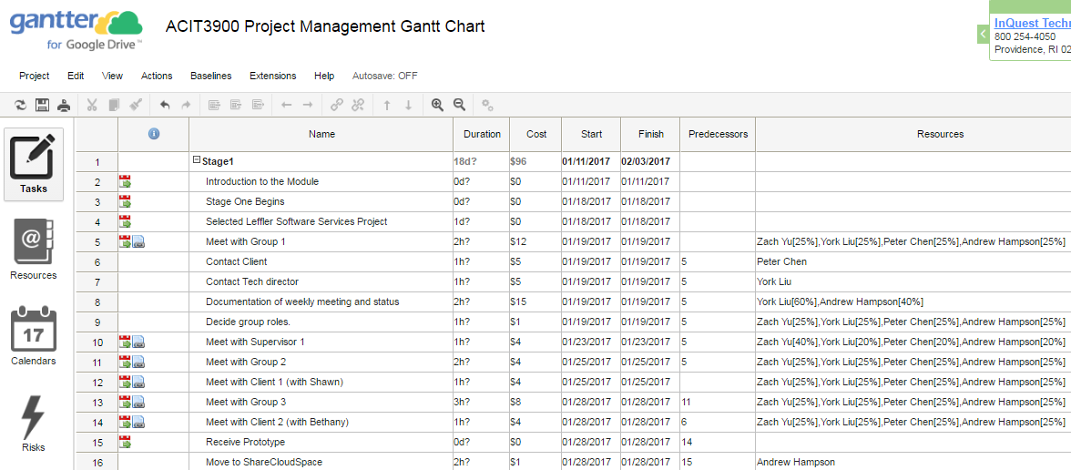
Group Organization
Task Assignment:
1.First Call First Get 2.One Task One Host 3.PM coordinates tasks Confliction.

Slide 9
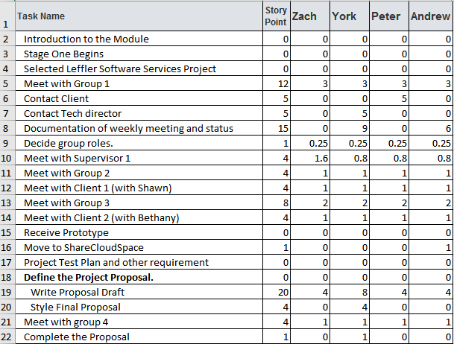
Group Organization
Evaluation
Story Points
Participation
Finished work on time

Slide 10
Project Phase
Phase 1
Phase 2
Final
Product
Phase 3
Phase 4

Slide 11

Project Phase 1
Contact client
Acquire original source code
Predict workload and scope
Prepare proposal
Test on AS3JS

Slide 12

Project Phase 2
Analyze ActionScripts structure and relationship
Create JavaScripts library supporting mxml
Research on ActionScript
Look for entry point of the app
Building from smaller pieces

Slide 13
Challenges and Difficulties
Confusing
Excessive
Confuse with Integration
Lack of Flash Knowledge
Excessive # of Scripts
Transpiler tool does not work as expected
Adapt to CreateJS
Tight Schedule
Struggling
No Time

Slide 14

Project Phase 3
Change Scope to Rebuild whole Web App with JavaScript
Design Playbook Web App
Three Designs from different angles
Assign tasks to Coding group
Testing Web App
Review the Pro and Con in three prototype Web Apps

Slide 15
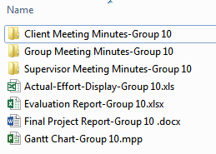
Project Phase 4
Combine good parts from two designs
Explore future improvement
Prepare final documentation
Summarize and Review All Works

Slide 16
Final Product
HTML5 Canvas + JavaScript EaselJS
Single File, Multi-function, Native Event Handling
Room for Improvement

Slide 17
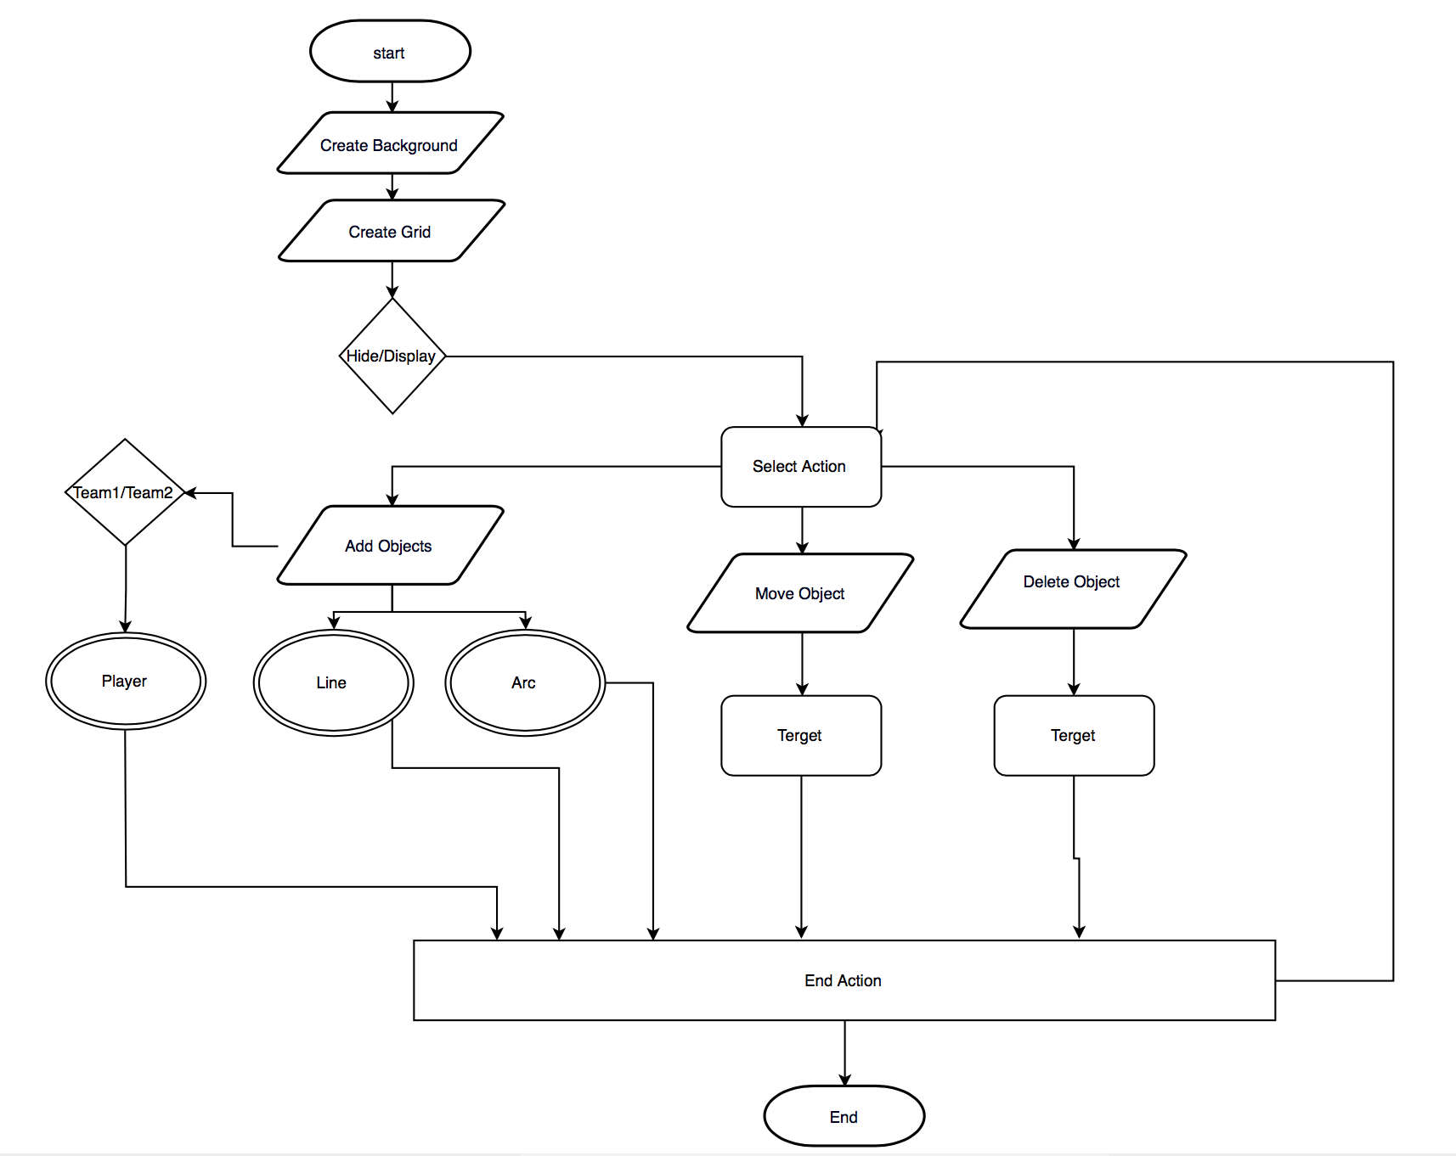
Prototype 1 Diagram

Slide 18

Demo Time

Slide 19
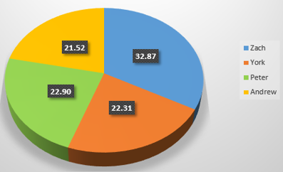
Group Growth
What went well?
Project Progress trace (gantt chart)
Group Management (regular Meeting, report)
Task Assignment (equal, effort record specifically)
IT support (actionscript, scope permission)

Slide 20
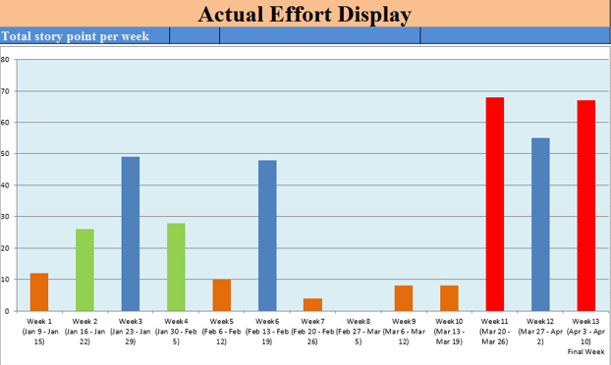
Group Growth
What went bad?
Design of original scope
Stuck in an unfamiliar language-- too much time

Slide 21
Group Growth
Andrew | Prioritisation and time management
Peter | Set deadline for each task, don’t waste whole time just on one thing
York | Information integration, record accuracy
Zach | Group Coordination, Expect to be professional

Slide 22
Question Time

